Slide 1




Slide 2
3 Non-technical Advantages of THE Linux operating system
Emre Geçit

Slide 3
outline
Transparency
Community
Security

Slide 4

Brief info about Linux
Developed by Linus Torvalds in 1991
An open source kernel

Slide 5
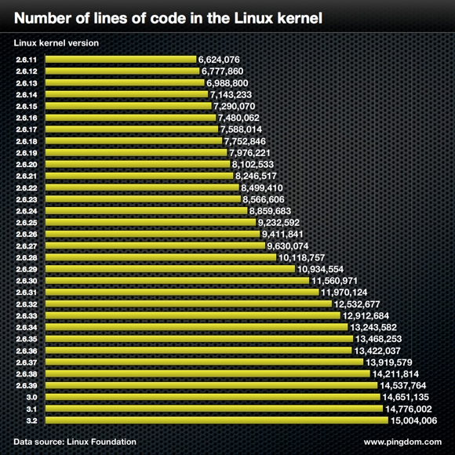
transparency
Linux is all open source.
There is no secret code or mechanism, everything is transparent.

Slide 6
Community
Linux has a great community.
The community develops and secures the operating system.

Slide 7
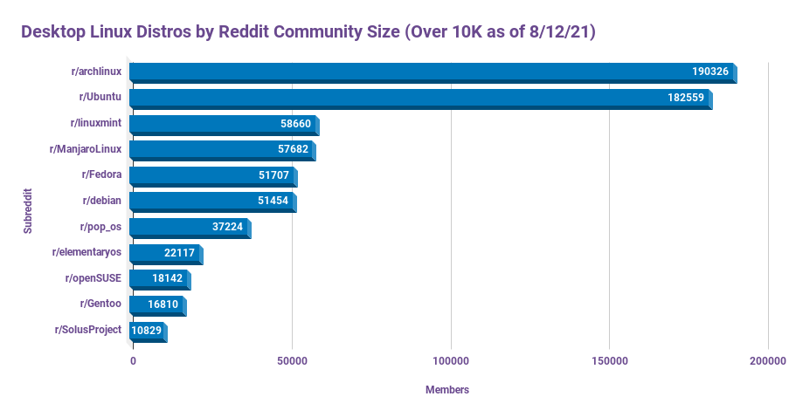
Reddit r/linuxmasterrace

Slide 8
Security
Not targeted by the hackers.
Vulnerabilities are patched by the community.

Slide 9
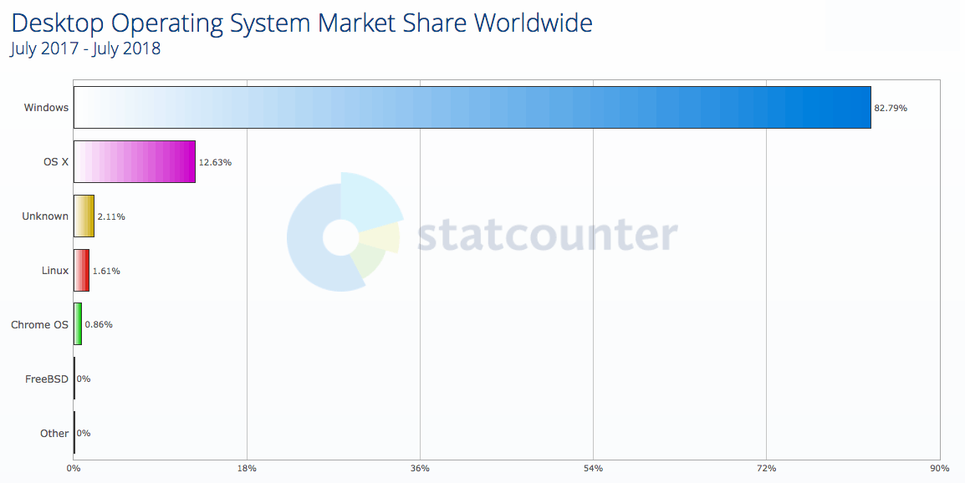
https://www.malwarefox.com/windows-virus-attacks/

Slide 10
References
Abraham, S. (2018, September 2). Why Windows get More Virus Attacks than Mac or Linux - MalwareFox. Malwarefox. https://www.malwarefox.com/windows-virus-attacks/
Anonymous, (2021, August 14). Desktop Linux Distros by Subreddit Community Size. Reddit. https://www.reddit.com/r/linuxmasterrace/comments/p4cu4v/desktop_linux_dis tros_by_subreddit_community_size/
Anonymous, (2012, April 16). Linux kernel development by the numbers. Pingdom. https://www.pingdom.com/blog/linux-kernel-development-numbers/
Travis, (2022, November 27). Why Linux Is The Most Secure Operating System – Systran Box. Systranbox. https://www.systranbox.com/why-linux-is-the-most-secure- operating-system/

